Slide 1

INSTITUTE - UIE
DEPARTMENT- ACADEMIC UNIT-2
Bachelor of Engineering (Computer Science & Engineering)
Subject Name: Introduction to Problem Solving
Code:22CSH-101
Strings
DISCOVER . LEARN . EMPOWER

Slide 2

OBJECTIVES
The course aims to provide exposure to problem solving with programming
The course aims to raise the programming skills of students via logic building capability
With the knowledge of C language students would be able to model real world problems
OBJECTIVES

Slide 3



CO Number | Course Outcome
CO1 | Remember the concepts related to fundamentals of C language, draw flowcharts and write algorithm/pseudocode.
CO2 | Understand the way of execution and debug programs in C language.
CO3 | Apply various constructs, loops, functions to solve mathematical and scientific problem.
CO4 | Analyze the dynamic behavior of memory by the use of pointers.
CO5 | Design and develop modular programs for real world problems using control structure and selection structure.

Slide 4
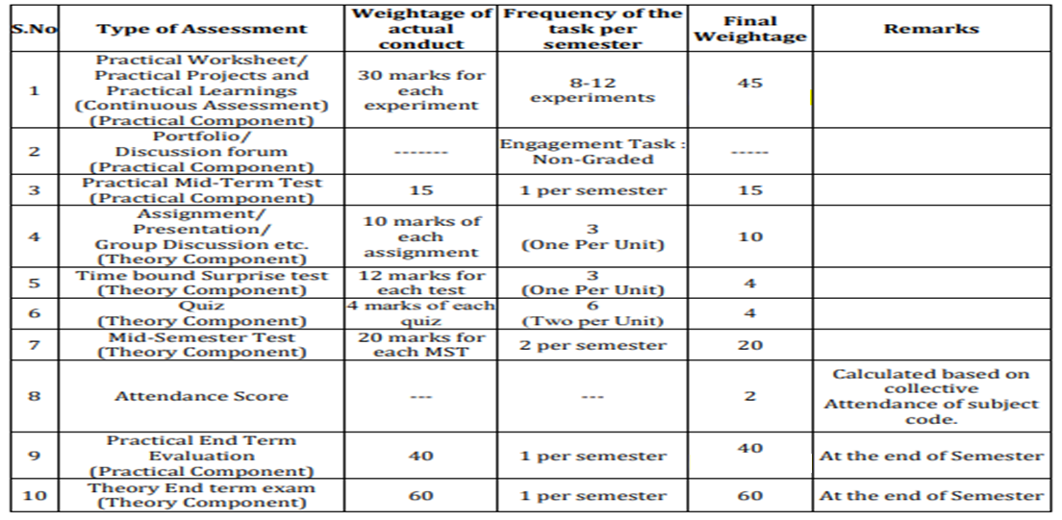
Scheme of Evaluation

Slide 5
Content
String Definition
Initialization of string
Memory Representation of String
String I/O functions
Examples
References

Slide 6
String
Def: A string in C is simply an array of characters ended with null character (‘\0’) This null character indicates the end of the string.
Strings are always enclosed by double quotes. Whereas, character is enclosed by single quotes in C.
Initialization of STRING:
char string[10] = {‘h’, ’e’, ‘l’, ‘l’, ‘o’, ‘\0’}; (or)
char string[10] = “Hello”; (or)
char string [] = “Hello”;
Difference between above declarations are, when we declare char as “string[10]”, 10 bytes of memory space is allocated for holding the string value. When we declare char as “string[]”, memory space will be allocated as per the requirement during execution of the program.

Slide 7
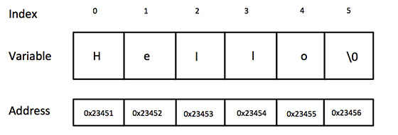
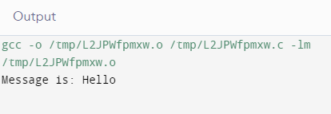
Let’s take an example for Memory representation of string:
char string[10]=”Hello”
Memory Representation in Strings
If you do not place null character at the end of string, the C compiler automatically places the '\0' at the end of the string when it initializes the array. If we print above mentioned string in C:
#include <stdio.h>
int main ()
{
char string[10] = {'H', 'e', 'l', 'l', 'o', '\0'};
printf("Message is: %s\n", string);
return 0;
}

Slide 8
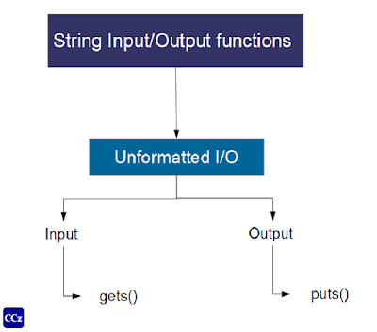
Input function scanf() can be used with %s format specifier to read a string input from the terminal. But there is one problem with scanf() function, it terminates its input on the first white space it encounters. Therefore if you try to read an input string "Hello World“ using scanf() function, it will only read Hello and terminate after encountering white spaces.
String Input and Output function

Slide 9
How to read a line of text?
You can use the gets() function to read a line of string. And, you can use puts() to display the string.
Example1 : gets() and puts()
#include <stdio.h>
int main()
{
char name[30];
printf("Enter name: ");
gets(name, sizeof(name), stdin); // read string
printf("Name: ");
puts(name); // display string
return 0;
}

Slide 10
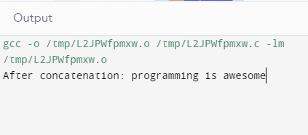
Example2: Concatenate Two Strings
#include <stdio.h>
int main()
{
char s1[100] = "programming ", s2[] = "is awesome";
int length, j; // store length of s1 in the length variable length = 0;
while (s1[length] != '\0')
{
++length;
} // concatenate s2 to s1
for (j = 0; s2[j] != '\0'; ++j, ++length)
{
s1[length] = s2[j];
} // terminating the s1 string
s1[length] = '\0';
printf("After concatenation: ");
puts(s1);
return 0;
}
Example of string

Slide 11
1.
A string in C is simply an array of characters ended with null character (‘\0’) This null character indicates the end of the string.
SUMMARY
2.
Use gets and puts functions for input a string
3.
Strings are always enclosed by double quotes. Whereas, character is enclosed by single quotes in C.

Slide 12
FREQUENTLY ASKED QUESTIONS
PROGRAMS
Q1 Write a C program to count no of lines, words and characters in a given text.
Q2 C program to print all VOWEL and CONSONANT characters separately
Q3 C program to count upper case, lower case and special characters in a string.
Q4 C program to print following pattern.
H
He
Hel
Hell
Hello

Slide 13
UTILISE YOUR KNOWLEDGE TO ANSWER
1 What is the Format specifier used to print a String or Character array in C Printf or Scanf function.?
A) %c
B) %C
C) %s
D) %w
2. What is the output of C Program with Strings.?
int main()
{
char ary[]="Discovery Channel";
printf("%s",ary);
return 0;
}
A) D
B) Discovery Channel
C) Discovery
D) Compiler error
Let us see how much you have learned from the lecture and how effectively you can apply your knowledge…!!

Slide 14
UTILISE YOUR KNOWLEDGE TO ANSWER
3 What is the output of C Program with Strings.?
{
char str[]={'g','l','o','b','e'};
printf("%s",str);
return 0;
}
A) g
B) globe
C) globe\0
D) None of the above
4 What is the output of C Program.?
int main()
{ int str[]={'g','l','o','b','y'};
printf("A%c ",str);
printf("A%s ",str);
printf("A%c ",str[0]);
return 0; }
A) A A A
B) A Ag Ag
C) A*randomchar* Ag Ag
D) Compiler error
Let us see how much you have learned from the lecture and how effectively you can apply your knowledge…!!

Slide 15
REFERENCES
Book References:
[1] Thareja Reema (2014) Programming in C. 2nd ed.
[2] Zed A. Shaw, Learn C the Hard Way’
[3] https://en.wikibooks.org/wiki/C_Programming
Vedio Lecture: https://spocathon.page/video/lecture-32-character-array-and-strings
https://www.youtube.com/watch?v=_3CmPbInJJs
Websites: https://www.tutorialspoint.com/objective_c/objective_c_strings.htm
https://www.programiz.com/c-programming/c-strings
https://www.studytonight.com/c/c-input-output-function.php
BOOKS
WEBSITES
COURSES

Slide 16

THANK YOU

